Slide 1
Week 11 Tutorial 01 — Big Steps a)

Slide 2
Week 11 Tutorial 01 — Big Steps a)

Slide 3
Week 11 Tutorial 01 — Big Steps a)

Slide 4
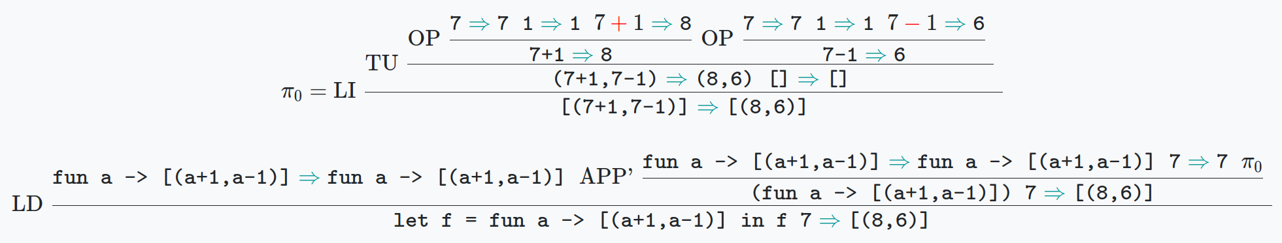
Week 11 Tutorial 01 — Big Steps a)

Slide 5
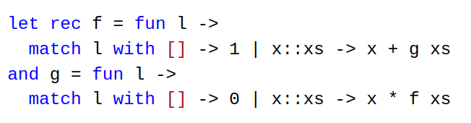
Week 11 Tutorial 01 — Big Steps b)

Slide 6
Week 11 Tutorial 01 — Big Steps b)
Global Definitions

Slide 7
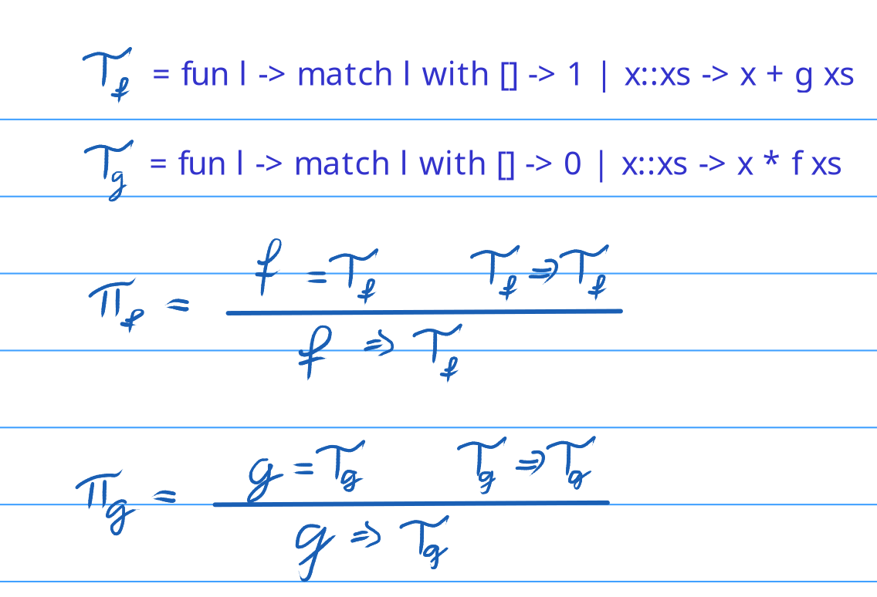
Week 11 Tutorial 01 — Big Steps b)
Global Definitions

Slide 8
Week 11 Tutorial 01 — Big Steps b)

Slide 9
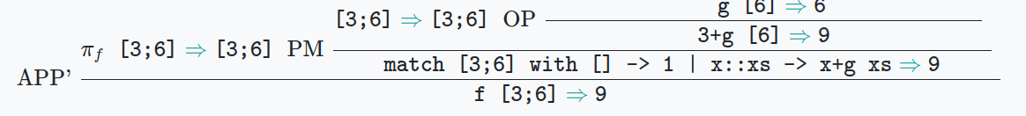
Week 11 Tutorial 01 — Big Steps b)

Slide 10
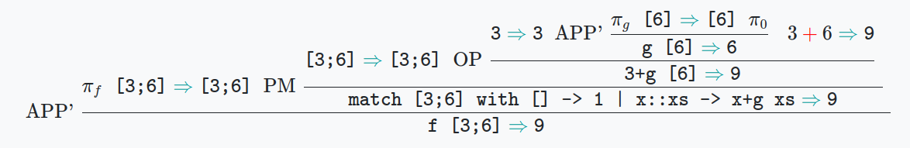
Week 11 Tutorial 01 — Big Steps b)

Slide 11
Week 11 Tutorial 01 — Big Steps b)

Slide 12
Week 11 Tutorial 01 — Big Steps b)

Slide 13
Week 11 Tutorial 01 — Big Steps b)

Slide 14
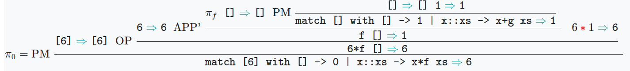
Week 11 Tutorial 01 — Big Steps b)

Slide 15
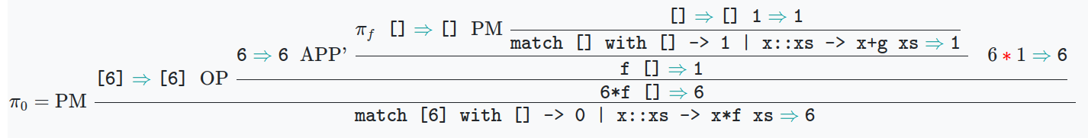
Week 11 Tutorial 01 — Big Steps b)

Slide 16
Week 11 Tutorial 01 — Big Steps b)

Slide 17
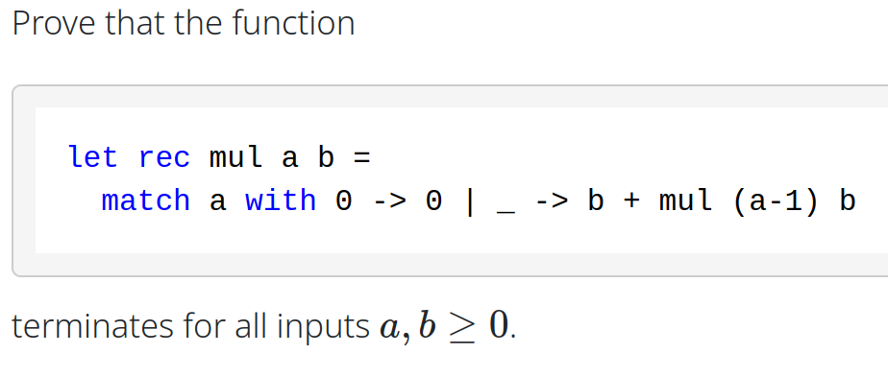
Week 11 Tutorial 02 — Multiplication

Slide 18
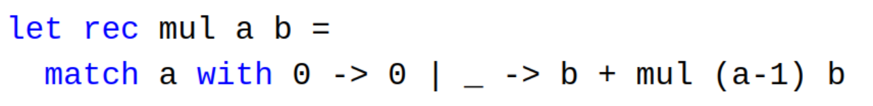
Week 11 Tutorial 02 — Multiplication
Proof by Induction on a
Base: a = 0

Slide 19
Week 11 Tutorial 02 — Multiplication
Proof by Induction on a
Hypothesis:
∀a ≥ 0: mul a b = a*b
Step:

